Slide 1
Nitrogen Cycle
The series of processes by which nitrogen and its different forms are circulated and interconverted in nature with the help of living organisms is called the nitrogen cycle.
Thus, Nitrogen Cycle is a biogeochemical process through which nitrogen is converted into many forms, consecutively passing from the atmosphere to the soil to organism and back into the atmosphere.
Nitrogen exists in both organic and inorganic forms:
Organic nitrogen exists in living organisms, and they get passed through the food chain by the consumption of other living organisms.
Inorganic forms of nitrogen are found in abundance in the atmosphere. This nitrogen is made available to plants by microorganisms like bacteria which can convert the inert nitrogen into a usable form – such as nitrites and nitrates.

Slide 2
Significance of Nitrogen – Nitrogen is essential component of amino acids, proteins, enzymes and nucleic acids (DNA and RNA) of the protoplasm.
Major Source of Nitrogen – Atmosphere (78.62 %)
Nitrogen is the most abundant element in the Earth’s atmosphere (78%).
Nitrogen cannot be absorbed directly by the plants and animals until it is converted into compounds they can use.

Slide 3
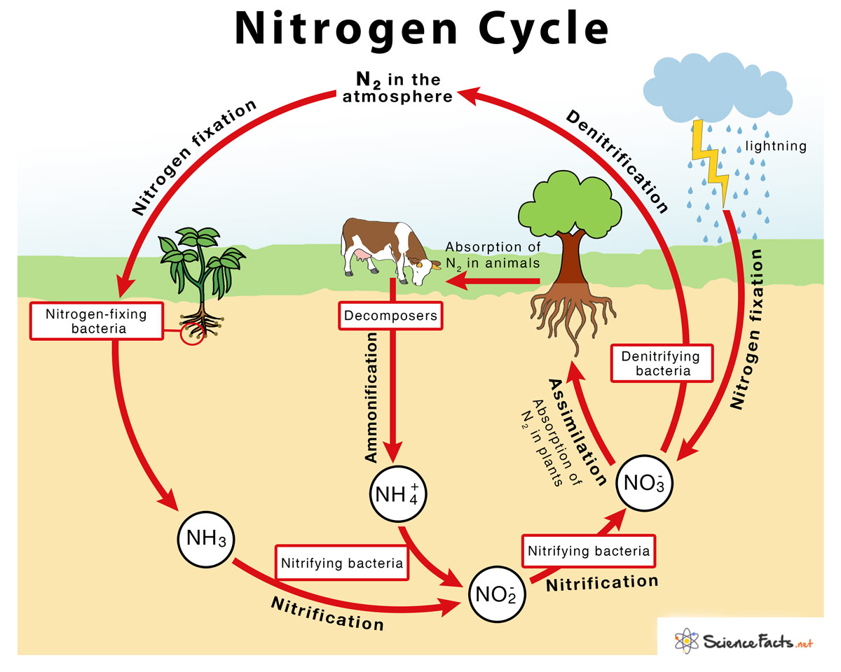

Slide 4
The entire process of the Nitrogen Cycle takes place in six stages:
1) Nitrogen Fixation – Converting inert atmospheric nitrogen (N₂)into biologically available forms such as ammonia (NH₃), nitrates, or nitrites.
It occurs in following ways –
(i) Biological nitrogen fixation: Performed by two different groups of bacteria –
a) symbiotic nitrogen fixers like Rhizobium, which keep a close association with the host leguminous plant, and
b) free-living, non-symbiotic bacteria like Azotobacter, Anabaena.
Both these group of bacteria use specific enzymes to complete the biological nitrogen fixation process by the following reaction –
N₂ + 8 H⁺ + 8 e⁻ → 2 NH₃ + H₂
(ii) Atmospheric nitrogen fixation by the help of lightening and thunderstorm. The energy of lightning breaks atmospheric nitrogen into nitrogen oxides which can then be utilized by plants for assimilation.

Slide 5
2) Nitrification – Converting ammonia to nitrite and then to nitrate. Performed by nitrifying bacteria in two steps–
i) Ammonia-oxidizing bacteria such as Nitrosomonas species perform oxidation of ammonia to nitrite by the following reaction–
2NH₄⁺ + 3O₂ + 8 e⁻ → 2 NO₂– + 4H₂ + 2H₂O
ii) Nitrite-oxidizing bacteria such as Nitrobacter species perform oxidation of nitrite (NO₂–) to nitrate (NO₃–) by the following reaction–
2 NO₃– + O₂ → 2 NO₃–

Slide 6
3) Assimilation by Plants – Absorbing nitrogen from the soil and incorporating them in the plant and animal bodies and utilizing it for making proteins.
4) Ammonification by Decomposers –Decomposers such as fungi and ammonifying bacteria like Bacillus ramosuns present in the soil convert the dead organic matter of plants or animals back into ammonia (NH₃) or ammonium ions (NH₄⁺).
5) Denitrification by Denitrifiers – Conversion of nitrites and nitrates into molecular nitrogen in the presence of denitrifying bacteria likeThiobacillus, pseudomonas and clostridium.
6) Sedimentation- sometimes after death of organism nitrogenous compounds are accumulated in rocks etc.

Slide 7
Importance of Nitrogen Cycle:
Helps plants to synthesise chlorophyll from the nitrogen compounds.
Helps in converting inert nitrogen gas into a usable form for the plants through the biochemical process.
In the process of ammonification, the bacteria help in decomposing the animal and plant matter, which indirectly helps to clean up the environment.
Nitrates and nitrites are released into the soil, which helps in enriching the soil with the necessary nutrients required for cultivation.
Nitrogen is an integral component of the cell and it forms many crucial compounds and important biomolecules.
Nitrogen is also cycled by human activities such as the combustion of fuels and the use of nitrogen fertilisers. These processes, increase the levels of nitrogen-containing compounds in the atmosphere. The fertilisers containing nitrogen are washed away in lakes and rivers and results in eutrophication.

Slide 8
Humans impact on the nitrogen cycle:
Human activities release excess nitrogen into the environment, eventually disturbing the balance of nitrogen in its different reservoirs in two possible ways:
Burning of Fossil Fuels
Use of Nitrogen-Containing Fertilizers
Burning fossil fuels like coal, petroleum, and natural gas releases excess nitrogen into the environment that accumulates over time. An increase in the concentration of nitrogen is found to affect the climate of the earth by gradually increasing its temperature, causing greenhouse effect and global warming.

Slide 9
When artificial fertilizers containing nitrogen as one of the components are washed away from the agricultural fields, it contaminates the nearby water bodies and also the groundwater making it more difficult for the plants to absorb the nitrogen both for the terrestrial and aquatic plants. Since nitrogen fixation by plants is affected, it affects the nitrogen cycle.

